Slide 1
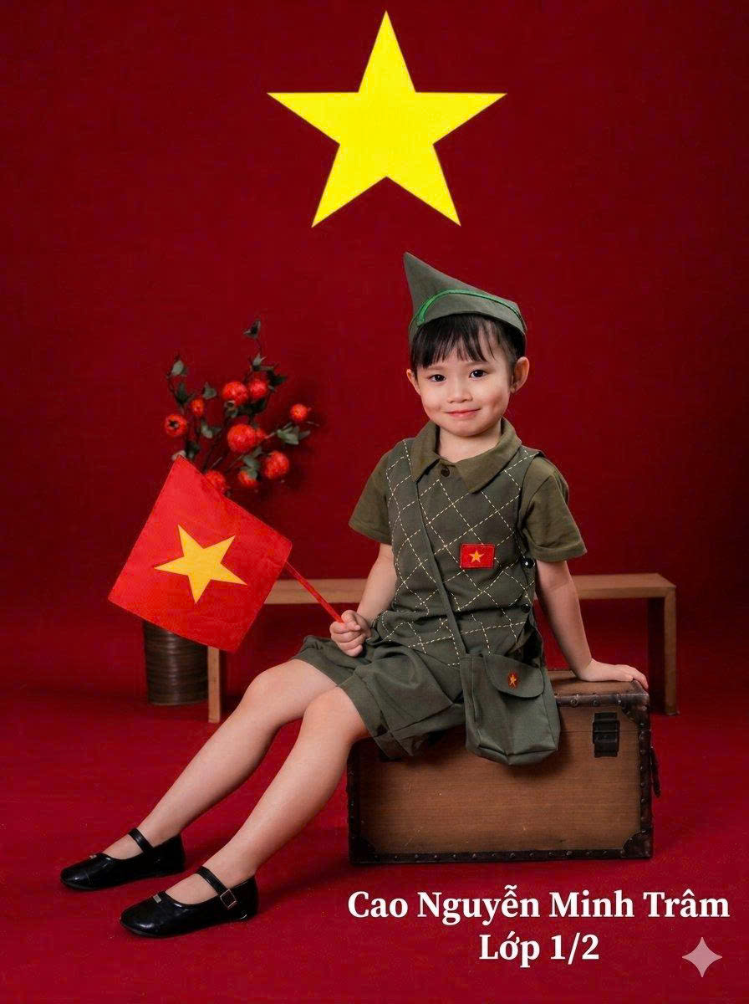

VIETNAMESE TEACHERS' DAY
Hello everyone,
My name is Trâm. I am six year-olds.
I am in Grade One at Tran Quoc Toan School.

Slide 2



Today, I want to talk about my teachers and my school.

Slide 3

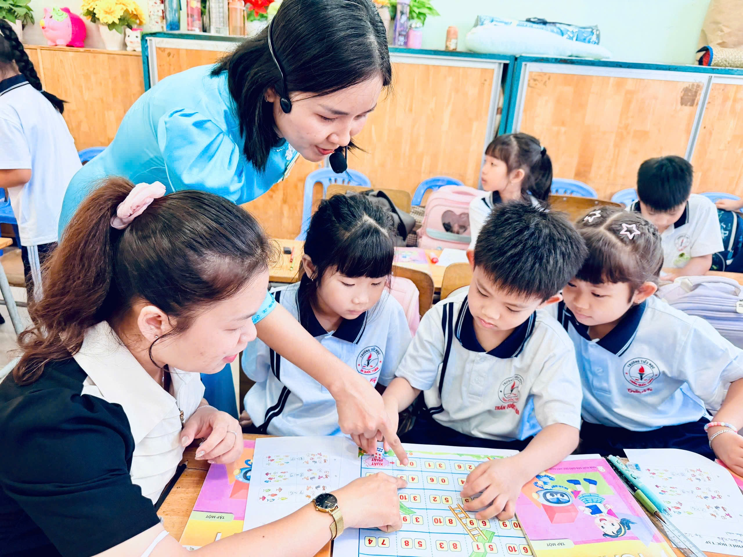
Thank you, teachers! You teach me and love me like my second mother.
You help me learn every day.

Slide 4
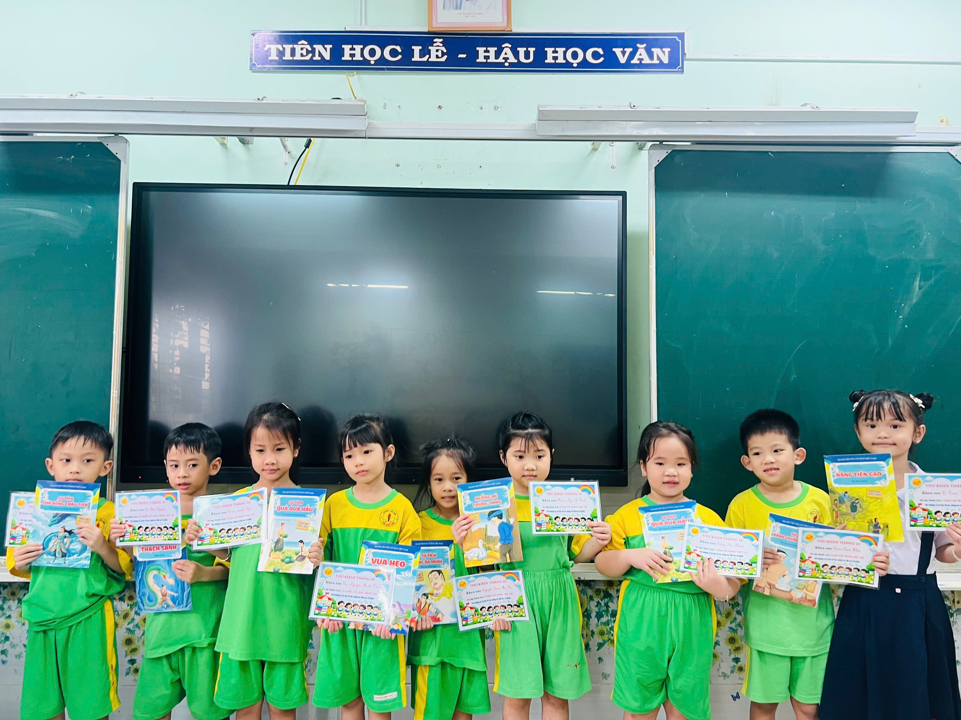

I will to be a good student, listen to you, and nice to my friends.
Listen to You
Listen to my teachers every day.

Slide 5
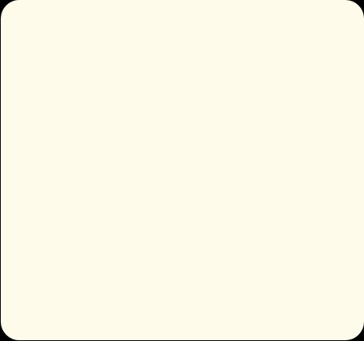
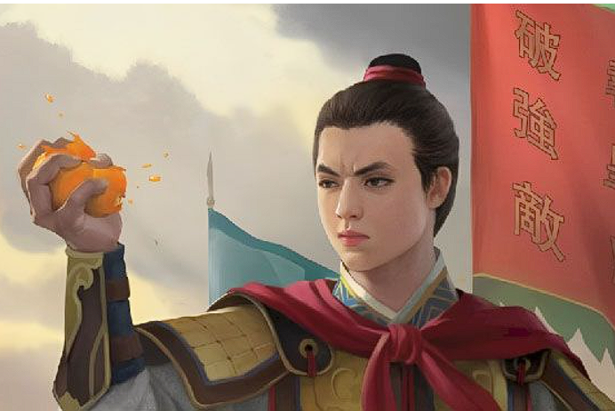
I love my school's name: Tran Quoc Toan.
He is a super hero!
He loves Vietnam, and I want to be like him!

Slide 6
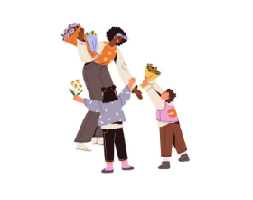
Happy Vietnamese Teachers’ Day!
I love my teachers, my school, and Vietnam!

Slide 7

Thank you for listening!
Goodbye!

